Slide 1
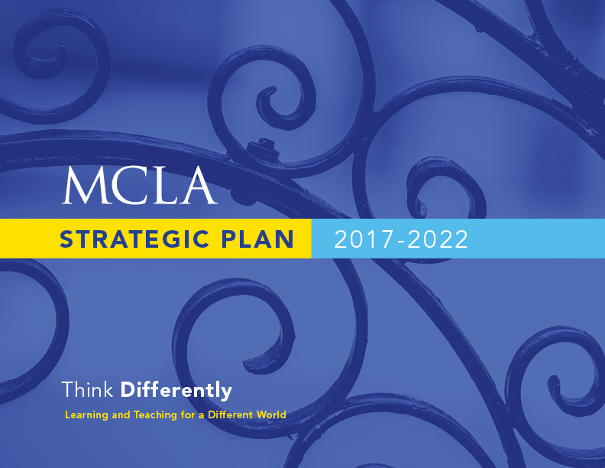

Slide 2


Progress in 2016-2017
Diversity, Equity, and Inclusion Initiatives
  Supportive and inclusive community survey
  Intergroup dialog training
  Commitment to hire Chief Diversity Officer
  Safe Zone trainings
New Academic Programs
  3-year business degree
  Community health education
  Health science
  Public history minor
Design Lab at 49 Main

Slide 3
Progress in 2016-2017, cont’d.
Recognition from U.S. Department of Education
  One of 26 four-year public and private colleges with “low costs and high salaries” for graduates
Title III Grant
Mellon Grant
Inclusive and successful strategic planning process

Slide 4
MCLA Today
  MCLA is breaking the cycle of poverty for many of our students.
    30% of financial aid recipients are from families earning <$30,000.
    46% of all undergraduates receive a Pell grant
      Highest among MA 4-year publics and among the highest among COPLAC institutions
  MCLA’s 4-year retention and graduation rates.
    First-to second-year retention rate (Fall 2016 cohort) = 72%: down from 78%
    4-year graduation rate for Fall 2013 cohort 52% -- highest in MCLA history
    ALANA graduation rate for Fall 2013 = 51.4%
    HIPs influence retention and graduation numbers.
    Three-year positive trend of students taking internships

Slide 5
MCLA Today
  Opportunities in Berkshire County abound.
    1700-1900 job openings in Berkshire County today, around half of which require a degree
    38% of MCLA grads live in Berkshire County.
    We are expanding our interactions with employers.
  MCLA provides high quality, liberal arts education, and workforce preparation that students can’t get elsewhere.
    MCLA is MA’s only designated Public Liberal Arts College – and 1 of 29 nationally with designation
    Focus on integrating liberal arts with work force development
    Total direct cost before aid is $20,400
    93% of 2015 graduates are employed or in graduate school.

Slide 6
Our Destination: MCLA in Five Years
building on our strengths and remaining faithful to our core commitments
a nationally known, top-choice destination
meeting every qualified admitted student’s full financial need
leading the state public higher education system in retention and graduation rates
cutting-edge, innovative, 21st-century curriculum rooted in the liberal arts that also is responsive to and connected with the evolving world of work

Slide 7
Our Destination: MCLA in Five Years
a model academic community where faculty and staff thrive and students’ lives are transformed
diversity at all levels of the institution, including in leadership roles
deeply rooted in its community and region
nimble and flexible, not afraid to make change or take calculated risks
more diversified funding sources, adequate to support ongoing operations and strategic investments
MCLA will be the #1-ranked public liberal arts college in the nation

Slide 8

LOOKING FORWARD
A call to action: THINK DIFFERENTLY!
If MCLA is to become the top-ranked public liberal arts, we must:
    Adapt our approaches to learning and teaching for a changing world…
      Be open to new ideas and new ways of doing things
      Eschew conventional wisdom and engage innovation
      Invest in proven or promising new practices
      Leverage our relatively small size and the nimbleness it affords us
      Tolerate risk and expect failures on the path to pioneering leadership in higher ed
    … while remaining true to the values, traditions and strengths that already distinguish us.

Slide 9
MCLA’s 2017-2022 Strategic Planning Goals
Respond to student and community needs in ways that enhance MCLA’s distinctiveness, its role as a pioneering educational leader, and its value as an engine of regional growth
Enhance student persistence, completion, and preparation for post-college success
Strengthen and demonstrate our commitment to diversity, equity, and inclusion
Attract and retain great talent and promote a campus climate that is collegial, collaborative, and creative
Improve internal communications and enhance our external reputation
Improve facilities and technology infrastructure in support of our mission
Promote enhanced organizational effectiveness
Diversify revenues and build a more sustainable financial model
Notes:
Nate or Monica
Here are the goals we propose be the pillars around which we continue building the strategic plan.
At this stage, we are very interested in the board’s general reactions to the emerging vision of Salem State in 2021 and particularly to this set of goals, which are designed to get us to that destination – a stronger Salem State in five years.

Slide 10

How Did a Rapidly Changing Recruitment Landscape
Influence MCLA’s Strategic Plan?
Gina Puc ’07
Director of Admission

Slide 11
Conditions Driving Enrollment Decisions
Tuition Discounting- 49.1%
  25% of institutions are over 50%!
More and Earlier Applications/Yield Down
  36% of H.S. seniors apply to 7 or more colleges.
  Students stay close to home
  Changing visit patterns
Larger Financial Need/ “Free Tuition” Programs
Increased Cost to Recruit Students
Source: NACAC State of College Admissions, 2015

Slide 12
Fall 2017 Admitted Student Questionnaire Results
Characteristics students rated very important and MCLA rated higher (than the means of all other colleges considered)
Cost of attendance
Personal attention
Quality of campus housing
Value for the price
Characteristics listed as very important and MCLA ranked lower (than the means of all other colleges considered) :
Academic reputation
Quality of majors of interest
Quality of academic facilities
Surroundings
Availability of majors
Extra-curricular activities
These results were taken into consideration during the strategic planning process.

Slide 13
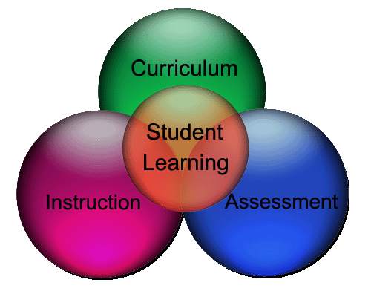
Thoughts on how the vision for 2022 will influence the future academic program at MCLA
Monica Joslin
Dean of Academic Affairs

Slide 14

Vision-Advancing Academic Program in Five Years
What will be different? Where will our focus be?
Focus on creating and expanding quality, relevant academic programs
Create, revise, expand undergraduate and graduate academic degrees and programs using an inclusive process
Provide more diverse and flexible program types and delivery options
Complete revision of the Core curriculum as a marquee program

Slide 15
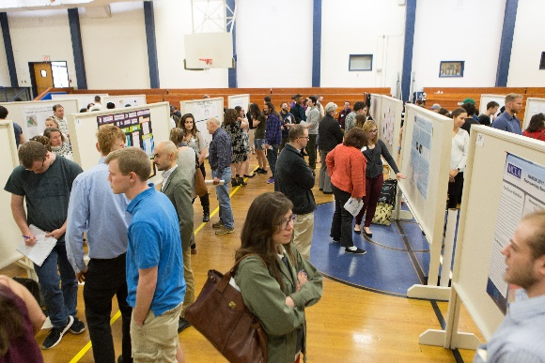
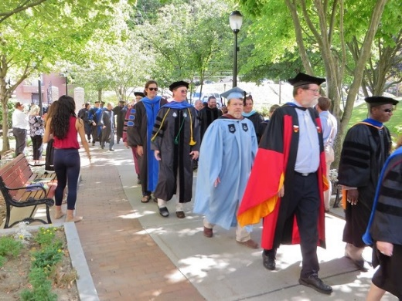
Vision-Advancing Academic Program in Five Years
What will be different? Where will our focus be?
Focus on enhancing our commitment to engaged, lifelong learning
Create and revise programs to promote inclusion, equity, and respectful learning environments
Continue to deeply integrate classroom with experiential learning (High Impact Practices)
Provide comprehensive preparation for career and citizenship

Slide 16
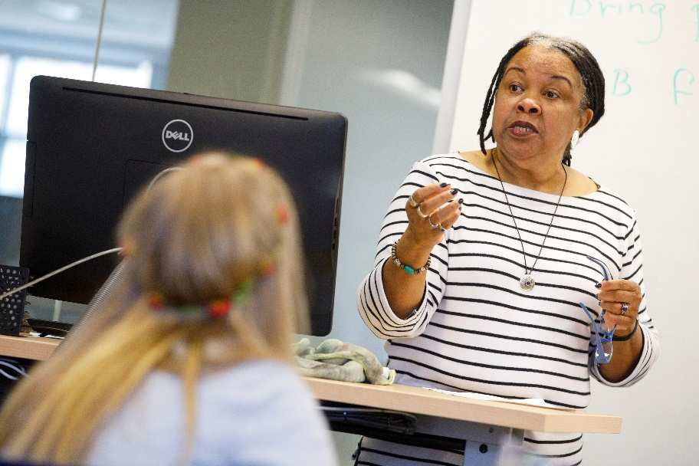
Vision-Advancing Academic Program in Five Years
What will be different? Where will our focus be?
Focus on continuously improving teaching
Strengthen support for faculty’s pedagogy, scholarship and professional development
Promote creative, inclusive, and entrepreneurial teaching in the classroom and beyond

Slide 17

Where are the most significant challenges and most promising opportunities relating to student success and retention?

Slide 18
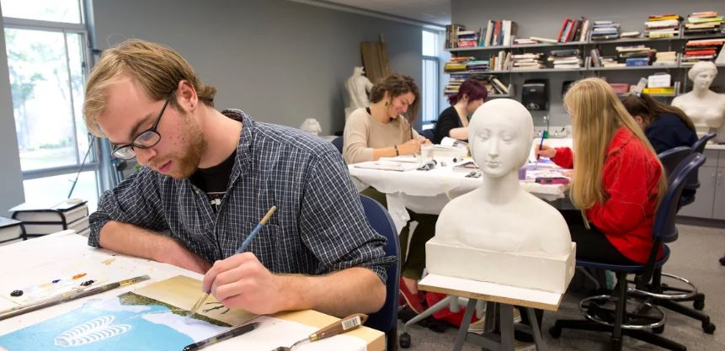
Student Success and Retention
STUDENT
Pell Eligible
Advising – “30 by 3”
High Impact Practices
INTERNSHIPS
Notes:
Positive Impact on student success …..4 year graduation:
“30 by 3” →35% (2010) to 52% (2017)
Focus on HIP

Slide 19
Student Success and Retention
Challenges – Non-returning:
  High financial need
  Undeclared students
  High Achieving Students
  HS GPA < 3.0
  ALANA
Promising Practices:
  First Year Experience Program
  Expand Living Learning Communities
  Undergraduate Research
  Internships / Career Preparation
  Continue to build a culture of Advising
  Continue to support/devote resources for student success programs (undeclared program, tutoring, SI program, “30 by 3”)

Slide 20

Why are we confident in the potential of HIPs?
Catherine Holbrook
Vice President of Student Affairs

Slide 21
High-Impact Practices
Widely tested and highly flexible - can be customized institutionally
Enhance student engagement and substantive interaction/dialogue with faculty and peers
Increase student transition to and satisfaction with college
Exposure to diverse perspectives and others with positive outcomes
Effective with all students; greatest effect with traditionally underserved populations
Promote lifelong learning and real-world skills

Slide 22
MCLA High Impact Experiences
Summer LEAD Program
STEM Academy
Core Curriculum Tier 1
First Year Experience Courses/Programs
First Year LLCs
Undergraduate Research
Community Action Courses
Residence area advisory board
Sustained service programs
Athletic team participation (intercollegiate)
Resident Advisor positions
Internships/Field Experience
Admissions Ambassador
Study away
LEAD Program Coordinator positions
Orientation Leader
Peer Mentor
Campus governance committee work
Club or organization leadership
CORE Tier III courses
Independent Study – Research
Senior Seminar
College & Academic Life
The World Outside the Classroom
Application Discipline to the Real World
First Year Encounters
Middle Years Encounters
Senior Year Encounters

Slide 23

How is revenue generation tied to the strategic plan?
What will make MCLA financially sustainable?
Larry Behan
Vice President of Administration and Finance

Slide 24
Revenue Generation & Diversification
MCLA is a tuition-dependent public liberal arts college
  State support covers only 32% of total operating costs
  Tuition and fees must cover most of the remaining gap
  Ancillary revenue options must be explored

Slide 25
Financial Model
Enrollment: UD, GR, and CE
Advancement/Fund Raising
Diversification of Ancillary Revenue Streams

Slide 26

How will the strategic plan’s priorities
(and unfunded initiatives) be translated into giving opportunities for donors?
Molly Fannon Williams
Interim Vice President for Institutional Advancement

Slide 27
Advancement’s Plans to Generate Revenue and Support for the Strategic Plan’s Priorities
Work more effectively across campus, especially with faculty
Create a staff team focused on alumni engagement
Focus a new staff team on building gift support at all levels
Incorporate diversity and inclusion goals into planning and outreach

Slide 28
Generating Support for the Strategic Plan’s Priorities cont’d.
Develop involvement, recognition and solicitation strategies for mid- and high-level donors
  Scholarship, endowment, internships, athletics, arts, academic programs
Work toward a comprehensive advancement program that matches college priorities with the interests and readiness of major and planned giving donors
  Prospect management system

Slide 29

Pivoting from Long-Term to Short-Term Focus: Next Steps
James F. Birge
President
Denise Richardello
Executive Vice President

Slide 30
Implementation Opportunities from Steering Committee and Tasks Forces - Completed
Realign/reorganize the Advancement office
Reorganize CSSE (budget-neutral proposal)
Offer workshops for faculty and staff on topics related to diversity and inclusion
Day of Dialogue and Engagement
Develop plan to use facilities during summer to generate incremental revenues
Aggressively pursue grant funding
Install signage for gender-inclusive bathrooms
Chief diversity officer position (plus initiatives)
Improving internal communication and decision making transparency

Slide 31
Implementation Opportunities from Steering Committee/Task Forces
Year One Priorities/Focus
Inclusive process and structure for developing and vetting proposed new academic programs
Improving internal communication and decision making transparency
Recruiting more diverse faculty and staff; convene ad hoc group
Address underlying issues affecting faculty concerns re: workload and work draft
Continued redesign of the core curriculum
Create an alumni engagement campaign
Examine retention barriers for high-performing students and identify strategies for removing them
Develop and implement plan for increasing revenues by expanding GCE and entrepreneurial programs
Develop aggressive plan to use facilities during summer to generate incremental revenues
Offer workshops for faculty and staff on topics related to diversity and inclusion
Day of Dialogue and Engagement
Aggressively pursue grant funding
Commit to pursuing Hopkins and Venable as top facilities priority with DCAMM and pave the way toward securing financing and executing the plan
Develop co-curricular transcript and secure staff to sustain the effort
Expand internships and career services capability/ infrastructure/programs
Convene group to develop strategy and plans for early-college programs and the DESE’s innovation pathway idea, and also accelerated programs (3-year model) for students who enroll with prior credits
Address Wi-Fi/cellular connectivity on campus

Slide 32
Implementation Opportunities from Steering Committee/Task Forces
May take longer
Stronger alumni network for multicultural and ALANA students
Explore creative financing/joint venture opportunities for renovating townhouses and student gathering spaces
Develop more articulation agreements with community colleges and dual enrollment
Offer workshops for faculty and staff on topics related to diversity and inclusion
Day of Dialogue and Engagement
“wiki”-like site for faculty and staff and students that clearly outlines all college policies and key processes
Develop plan to use facilities during summer to generate incremental revenues
Aggressively pursue grant funding
Market research and development of a comprehensive marketing plan
Hire an instructional designer to increase online programs
Improving internal communication and decision making transparency
Explore creative financing/joint venture opportunities for renovating townhouses and student gathering spaces

Slide 33
What will be our process for inviting “strategic initiative” action plans and proposals?
Administrative departments will launch process first
VP of division will forward requests to department heads
All employees are encouraged to participate through departmental conversations
Requests should include specifics on:
    what goal (s) align with the plan
    definition of activities
    collaboration with other departments
    financial resources needed, if any
    how will success be measured
    metrics associated with anticipated outcomes

Slide 34
What will make a potential action plan rise to the top?
Advance one or more of the strategic plan’s goals
Align with and support the DHE’s top priorities (access, retention, completion, workforce alignment)
Raise MCLA’s profile locally and beyond
Enhance MCLA’s reputation
Leverage existing strengths and assets, including our location
Differentiate MCLA from its peers/competitors
Open new markets for MCLA
Help attract new/more students
Generate measurable/demonstrable and sustainable results
Utilize research-based best and/or high-impact practices
Generate incremental revenue or reduce expenses/promote efficiencies
Appeal to external funders
Improve staff and faculty morale

Slide 35
Action Plan Timeline
October 15th Administrative department requests shared
October Academic process determined
October 24, 31 Department of Higher Education approval
December 15 Administrative action plans due to divisional VP

Slide 36
Special Thanks
Strategic Planning Committee Co-Chairs: Gina Puc and Adrienne Wootters
All members of the Committee representing faculty, staff, students, board of trustees
All in this room who supported and participated in the planning process

Slide 37
Questions?
Reactions?

